Slide 1
Driving Readiness for Teens (DRT) Program Outreach & Therapist Training
by
Extra Credit! LLC
Notes:
Let me tell you briefly about myself and why I’m here today.

Slide 2
Training Objectives
Understanding the importance of community mobility
Understanding the risk of driving for teens in general
Learning performance areas & components of driving readiness
Learn ways to assess and prepare young teens for safe driving.
Improve awareness of responsibilities & resources

Slide 3
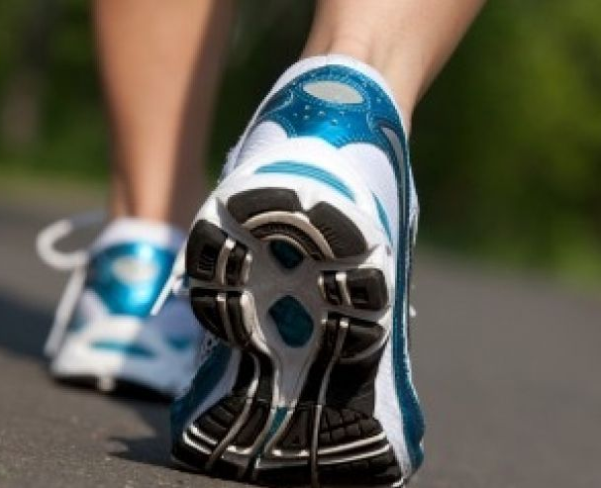
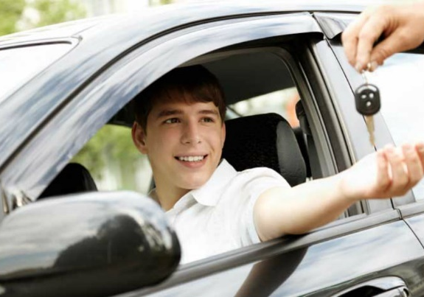
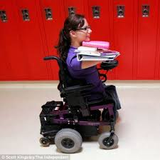
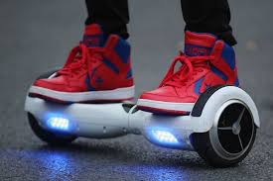
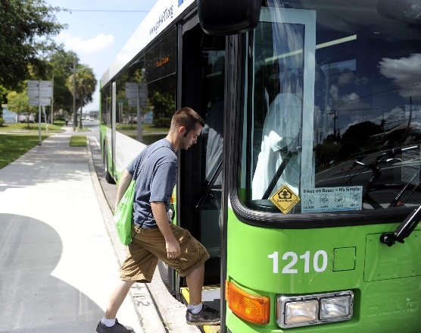
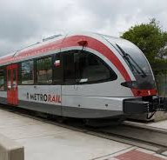
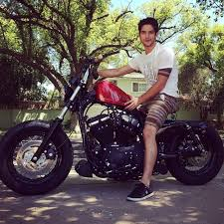
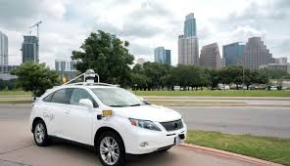
What is Community Mobility?
Getting from one location to another regardless of the mode
Notes:
Walking/moving, riding, and driving
bike, motorcycle/scooter, skateboard, hoverboard
Taxi/Uber, Bus, Train/Rail
Wheelchair, Adapted Vehicle, Self-Driving Car!

Slide 4
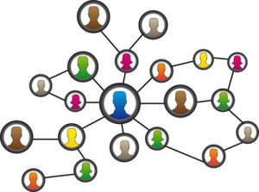
Why is Community Mobility important?
It is a necessary part of human independence and socialization
Friends & Family
School & Extracurriculars
Work & Volunteering
Goods & Services
Recreation
& Hobbies
Church & Support Groups
Notes:
Ask yourself the question: how readily available is my social support network because of the mobility options available to me?
Then consider how our therapy clients who may not be able to drive or who have limited community mobility skills are going to be independent and social beings.
Community Mobility not only allows us more options for independence, work, hobbies, and health, but is also how we builds helpful connections – which is termed “social capital”
Social capital is a term that has both economic and cultural origin. It essentially refers to “wealth” or “accessibility of resources” that are often mutually impactful or beneficial

Slide 5
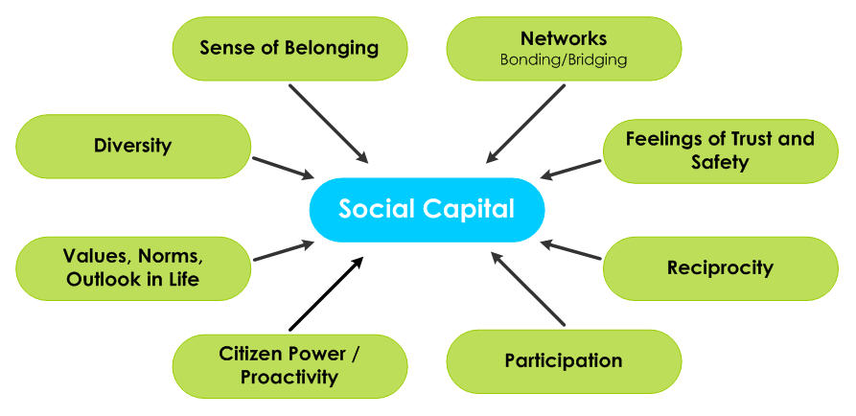
Building Social Capital Through
Our Support Networks
Notes:
Here we see the connections that social capital can bring
Essentially, the more mobile we are the more access we have to friends and groups which provide us a sense of belonging and security.
The more people we meet, the more connections we have and that can bring to us new friendships and opportunities
Mobility allows us to experience new people, places, and things which can influence and shape us in many ways
So again, community mobility is important because it builds social capital

Slide 6
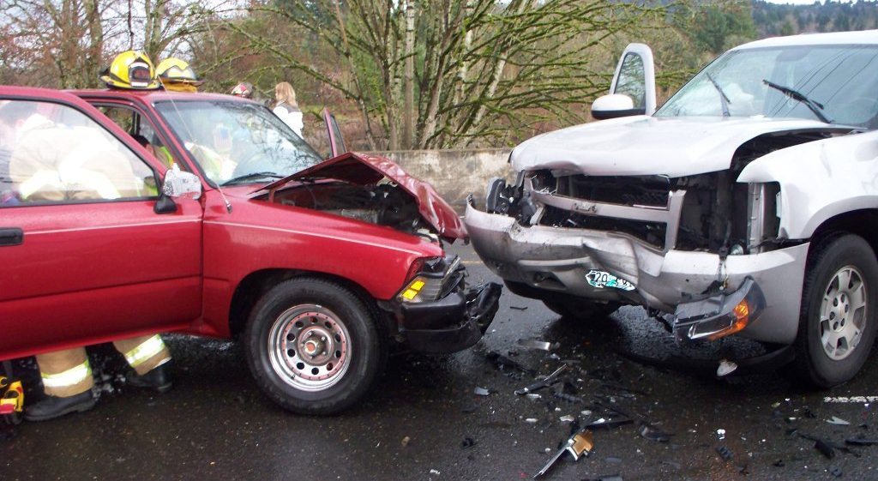
Community Mobility vs Driving
While most individuals can use public or private transportation,
not everyone can or should drive.
Notes:
Driving itself is the #1 killer of teens. (Not taking into consideration added risks that our clients will have)

Slide 7
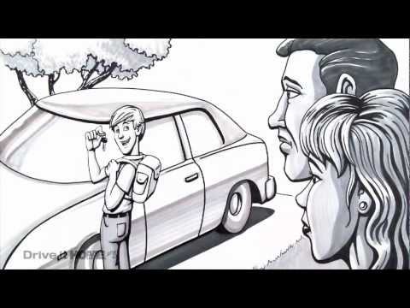
Notes:
Drive It Home

Slide 8
Drive it Home™ from the National Safety Council offers free parent resources, including digital driving lessons, courses, programs, and videos.
driveithome.org
Notes:
https://youtu.be/SAJPyfoEQMc

Slide 9
Austin Municipal Court statistics for moving violations: ages 16-19 the past 3 years
Description | *Accident | *No Accident | Total
Speeding – State HWY | 3 | 5,889 | 5,892
No Driver’s License | 847 | 4,089 | 4,936
Speeding – Posted City St | 1 | 2,726 | 2,727
Ran Red Light | 160 | 919 | 1,079
Failed to Maintain Clear Distance – Collision | 877 | 114 | 991
Ran Stop Sign | 25 | 568 | 593
Unsafe movement L/R | 240 | 143 | 383
Failed to signal intent to turn | 1 | 67 | 68
Failed to yield – L turn intersection | 241 | 85 | 326
Failed to yield - pedestrian in crosswalk | 4 | 24 | 28
Failed to yield intersection w/device | 26 | 5 | 31
Notes:
2013-2015
*Told by Adminstrative Specialist “collision numbers may not be accurate because sometimes an officer forgets to check the collision box on the citation. The court does not have any information on fatalities.”
Speeding: Sensory Seeking, ADHD, Poor orgaization/time management…. Consider restricted driving rules, technology to track driving routes & speed
No License: Why? Clubbing? Organizational systems?
Red Light: Good Role Models!
Everything on list: Emphasize speed/visual or mental focus

Slide 10
Region 13 Reportable Motor Vehicle Traffic Crashes Involving Drivers Ages 15-19
County | 2010 | 2011 | 2012 | 2013 | 2014
Bastrop | 183 | 171 | 181 | 165 | 238
Bell | 996 | 763 | 930 | 834 | 813
Blanco | 18 | 15 | 16 | 20 | 20
Burnet | 134 | 103 | 107 | 129 | 120
Caldwell | 67 | 79 | 84 | 103 | 86
Comal | 451 | 437 | 411 | 380 | 386
Fayette | 69 | 72 | 76 | 85 | 65
Gillespie | 77 | 66 | 64 | 71 | 67
Gonzales | 44 | 49 | 40 | 61 | 59
Guadalupe | 424 | 389 | 354 | 364 | 390
Hays | 500 | 440 | 488 | 478 | 540
Kendall | 135 | 151 | 157 | 125 | 152
Lee | 59 | 41 | 71 | 46 | 64
Llano | 43 | 32 | 29 | 43 | 42
Milam | 80 | 70 | 57 | 65 | 85
Travis | 2,068 | 1,952 | 2,025 | 2,006 | 2,073
Williamson | 737 | 577 | 681 | 896 | 1,068
Notes:
These stats are from our Teen Safe Driving Coalition. Stats from 2015 will be coming out this Spring. For this presentation we selected only Region 13 counties.
It’s pretty clear to see that MVT crash statistics involving teens are highest in more populated and heavy traffic areas (such as Austin metro areas) whereas smaller communities have less crashes.

Slide 11
CDC’s National Teen Driving Stats
2006
1 teen traffic death every ~2 hours on weekdays
1 teen traffic death every ~1 hour on weekends
25% of drivers ages 15-20 who were killed in crashes had Blood alcohol .08 or higher
31% of those drivers who were killed had been drinking and 77% of these drivers were unrestrained
2009
3,349 teen passenger vehicle occupants, ages 16 to 20, were killed in motor vehicle crashes, and 56% (1,880) were unrestrained at the time of the fatal crash.
2014
At least 6,531 teens died in motor vehicle accidents
Motor vehicle accidents were the leading cause of death for ages 15-24.
Notes:
Here again are some more concerning stats for teens nationwide. Notice that weekends and alcohol are included on this slide.

Slide 12
Preliminary estimates for 2015 from the National Safety Council
Motor vehicle deaths in 2015 increased by largest percent in 50 years
Showed 8% increase in 2015 than in 2014
They estimated 38,300 people were killed on U.S. roads, and 4.4 million were seriously injured, meaning 2015 likely was the deadliest driving year since 2008.
Pedestrians represent 7% of the fatalities in crashes involving teen drivers.
The pedestrian fatality rate increased at the fastest rate ever recorded in 2015.
Notes:
These NSC stats include some pedestrian numbers which is also important. Our kids with inattention or poor speed of processing/judgements could be walking and distracted.

Slide 13
National Fatal Crash Rates per Mile
for Ages 16-19
In the United States, the fatal crash rate per mile driven for 16-19 year-olds is nearly 3 times the rate for drivers ages 20 and over.
Risk is highest at ages 16-17. The fatal crash rate per mile driven is nearly twice as high for 16-17 year-olds as it is for 18-19 year-olds.
*The following facts are from the Insurance Institute for Highway Safety, posted in February 2016, and are based on analysis of data from the U.S. Department of Transportation's Fatality Analysis Reporting System (FARS).
Notes:
Finally, I added this slide because it has stats from 2016. I also think it points out that younger, more inexperienced teen drivers are most at risk. This is important to consider because with our therapy clients, who often have delays in various areas of development, it’s likely that we might want to postpone driving a few years for them anyways.

Slide 14
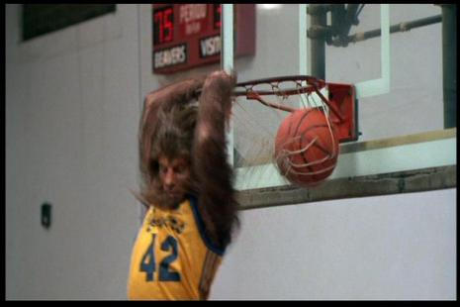
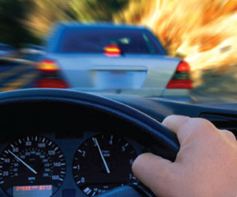
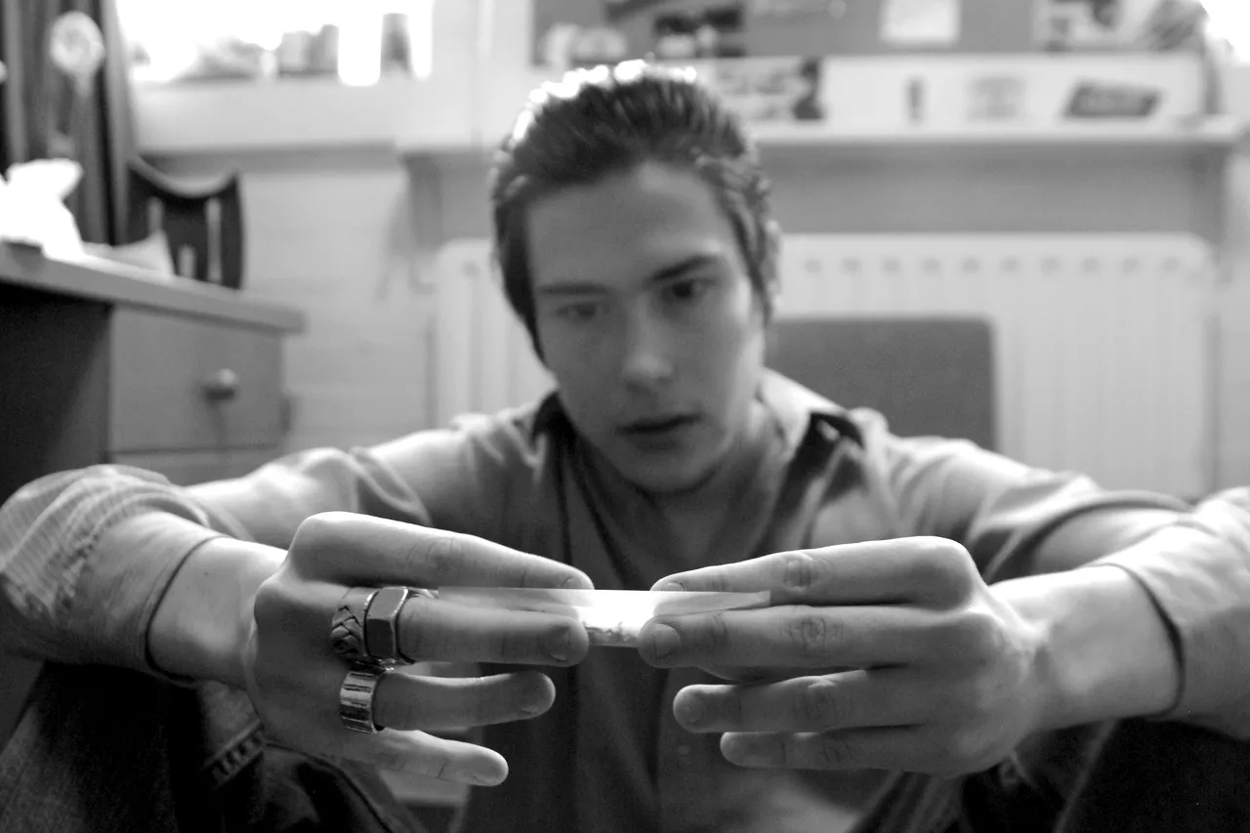
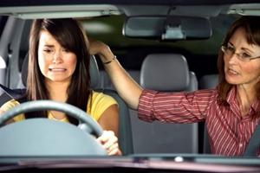
Community Mobility vs Driving
Consider IQ, Physical Ability, Behavior, Child/Parent Feelings
Notes:
We are not driving rehabilitation specialists that can help with vehicle modifications but if looking for driving aides and modifications:
Advanced Mobility Systems of Texas: Dallas/Fort Worth, Austin http://www.advancedmobility.net/

Slide 15
Driving Skills
Driving requires complex integration of brain and body skills.
A driver must be able to effectively filter and process incoming sensory stimulation while attending and responding to “most critical” information.
One must also be knowledgeable about rules of the road, have good anticipation skills, and be capable of managing unexpected events as well as stressful situations.
Notes:
This is from my blog for Drive it Home from Feb 2016. I also have a blog posted on Therapy Fun Zone about The Important Role of Pediatric OT in Driving Readinss with Adolescents. You might want to check both of those out for additional tips and information.
Let’s consider what this slide says and then apply it on the next slide.

Slide 16
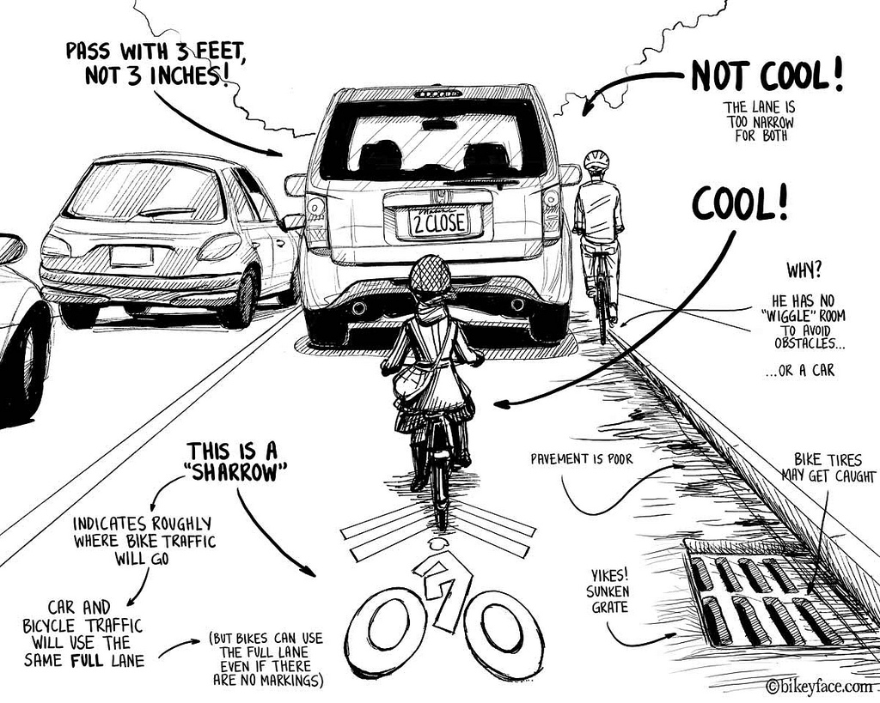
Notes:
Okay, let’s talk about filtering and processing of information here. There is a lot going on both visually and mentally and that’s pretty much what the driving process is all about, right?
You’ve got a bunch of critical information to look out for here (the cars, the drainage grate, pavement markings, a scooter or bike and another bicyclist)
I don’t know about you but this feels chaotic to me and as a person with anxiety, under stress it can be hard for me to access the cognitive (like rules of the road or where i’m even going) I’m really just trying to manage what I can do to avoid hitting these bikes.
Think about kiddos you see and how they would process a situation like this. Driving safety, I think is mostly about knowing what to do and how to react during stressful situations. But there is a lot you should notice in your clients (or adolecent children for us parents) when considering prepardness for driving.

Slide 17
Notice how the teen
...moves,
...sees,
...thinks,
...feels,
...and takes on general
responsibilities.

Slide 18
Considering General Readiness
All of the following attributes will, in some way, affect driving performance:
Coordinated use of extremities
Quick/accurate visual & cognitive processing
Executive functions
Safe attention and reasoning abilities

Slide 19
Pre-Driving Skills
Performance Areas
Activities of Daily Living
Functional Communication
Functional Mobility
Community Mobility
Emergency Response
Work & Productive Activities
Home Management
(Money, Meal Prep, Laundry,
Safety Procedures, Maintenance)
Care of Others
Educational/Vocational
Notes:
*Uniform Terminology for OT – 3rd edition
Aspects of the Domain (AOTA, 2008):
Driving and community mobility involve performance patterns using habits to operate equipment and routines to travel on an established route. Individuals fulfill the duties and responsibilities of life roles by engaging in community mobility.

Slide 20
Pre-Driving Skills
Performance Components
Sensory
Neuromusculoskeletal
Motor
Cognitive Integration
Psychosocial
Psychological
Notes:
*Uniform Terminology for OT – 3rd edition

Slide 21
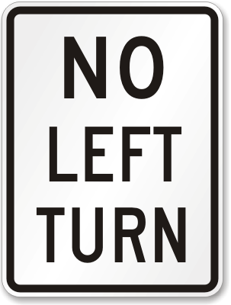
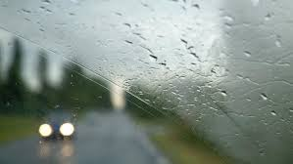
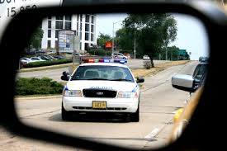
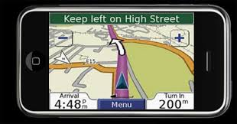
1. Sensory Processing Functions
Vision: Acuity, Depth Perception, Spatial Relations, Figure Ground, Form Constancy, Memory, etc.
Auditory Processing Skills
Discrimination & Praxis
Notes:
Engagement in driving and community mobility require one to have intact sensations and to perceive sensory input accurately. (AOTA, 2008)
Vision: Is the teen able to attend to all important visual signs and objects while driving?
Auditory: Is the teen able to hear sirens and attend to other important sounds around him while safely driving?
Right-Left Discrimination: Can the teen determine which direction is right or left and which blinker he/she should use to signal the correct direction?
Depth Perception: Can the teen see the stop sign or light and make a safe and controlled stop without going into an intersection?

Slide 22
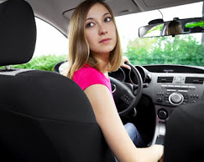
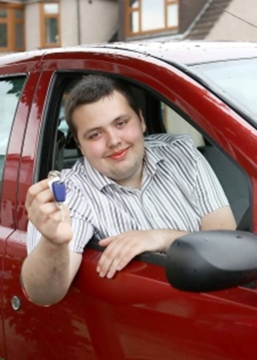
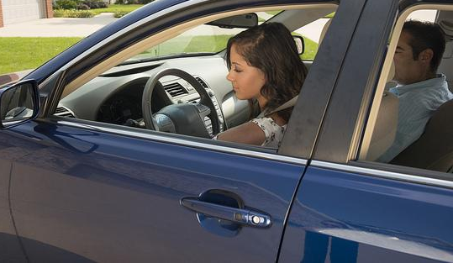
2. Neuromusculoskeletal Areas
Reflexes & Integration
Range of Motion
Strength
Tone
Endurance
Postural Control/
Alignment
Notes:
Reflexes: How quickly can the teen react to visual cues? Stoplight (red, yellow, or green)? Stop sign or yield? Car pulls out in front of them?
Are all of the reflexes integrated or are there still some persistent reflexes? ATNR? STNR? TLR?
Range of Motion: Can the teen turn his/her head far enough to either side to see car’s coming?
Postural Control/Alignment: Can the teen maintain good posture while driving to ensure the mirrors are in the correct position to see critical objects or signs around them and that they are able to have good alignment while turning their head to check L and R for any traffic?
Strength/Endurance: How far can the teen drive or be a passenger in a car before fatiguing physically and mentally?

Slide 23
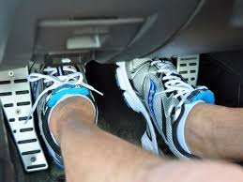
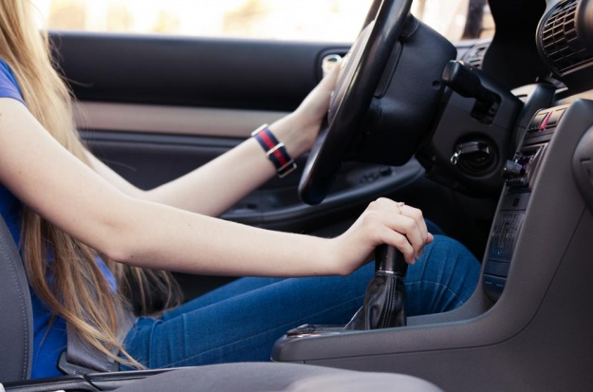
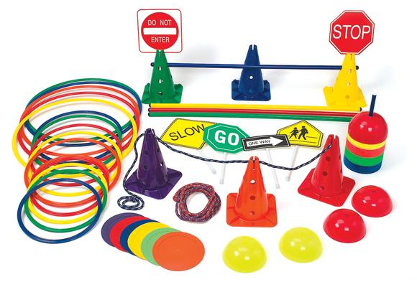
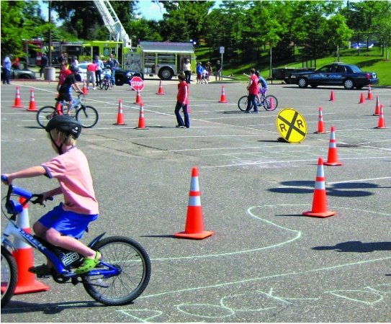
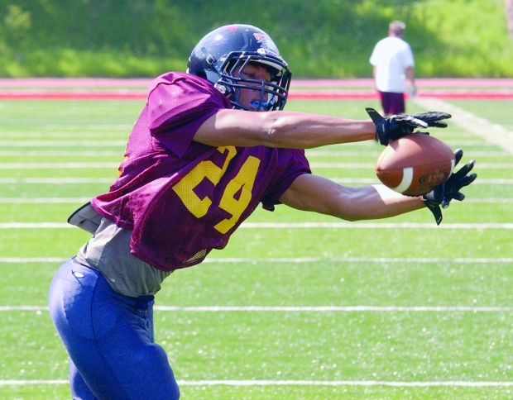
3. Motor Development
Gross Motor Coordination
Bilateral Integration
Visual Motor Functions
Notes:
Must use motor and praxis skills to physically move in a planned, coordinated, sequenced manner to operate a motor vehicle, use transit services, or exert bodily control for walking or bicycling. (AOTA, 2008)
Can the teen use both hands on the wheel while also using the foot for the brake and gas pedals?
Can the teen manipulate the turning knob for windshield wipers in chance of rain?
Will the teen be able to make a coordinated gross/fine motor response based on perceived visual demands around them? (visual motor integration)

Slide 24
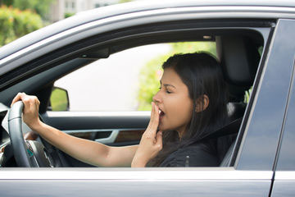
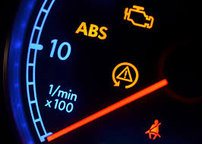
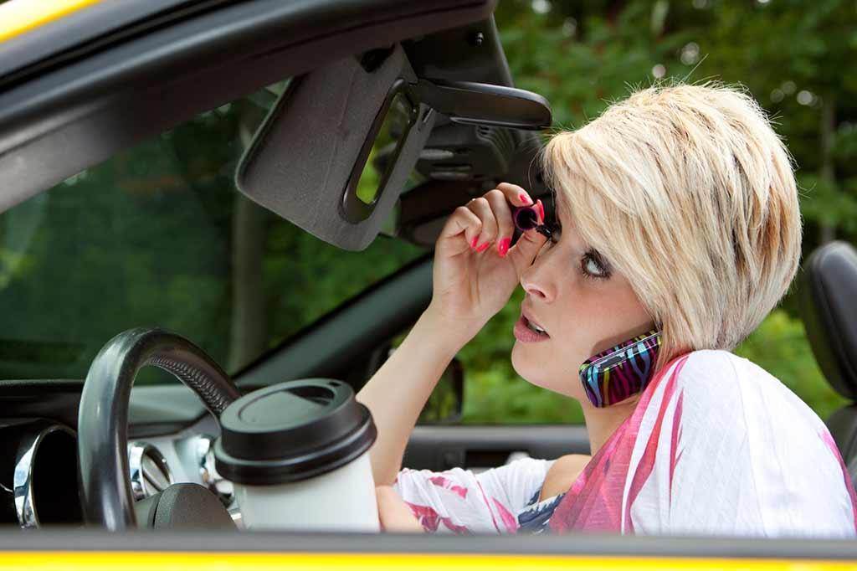
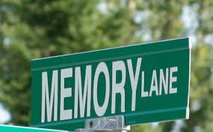
4. Cognitive Integration
Level of Arousal
Orientation
Recognition
Attention
Memory
Sequencing
Problem Solving
Generalization
Notes:
Driving and community mobility require cognitive skills to exercise sufficient attention, judgement, organization, memory, and multitasking while moving through the dynamic unpredictable environment. (AOTA, 2008)
Examples from continuing education course:
Students with ADHD typically have difficulty with using selective attention while driving.
Students with autism may have difficulty with generalizing information to different driving situations.
Questions
In teen able to control their level of arousal in different situations?
Does the teen know how to get around the neighborhood he/she is driving through?
Can they pay attention to all signs, cars, pedestrians, and other objects?
Can they remember a sequence of directions given?
Can they problem solve a find a new route if there is traffic or a detour?
Will they be able to generalize driving in different areas and on different roads than the initial area they learned how to drive?

Slide 25
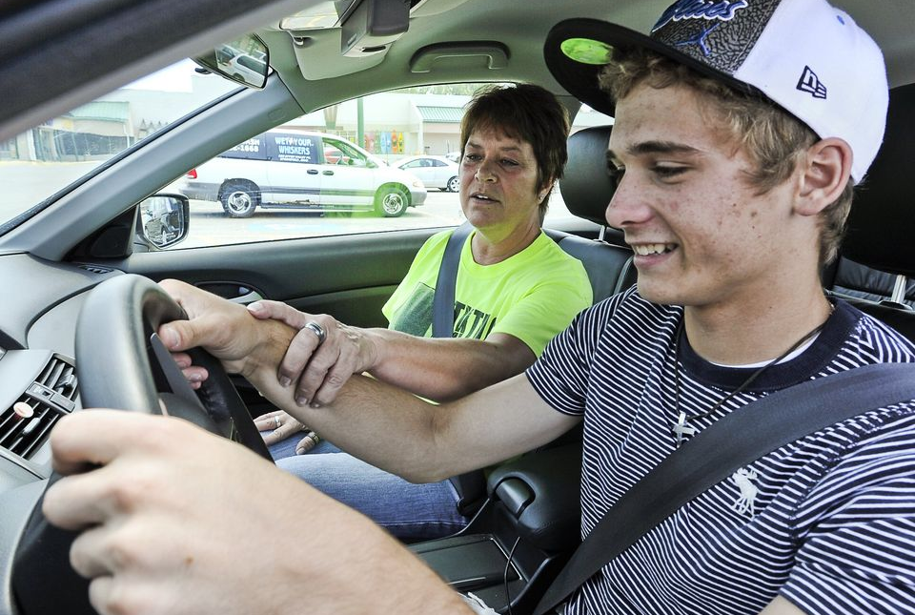
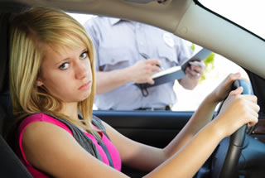
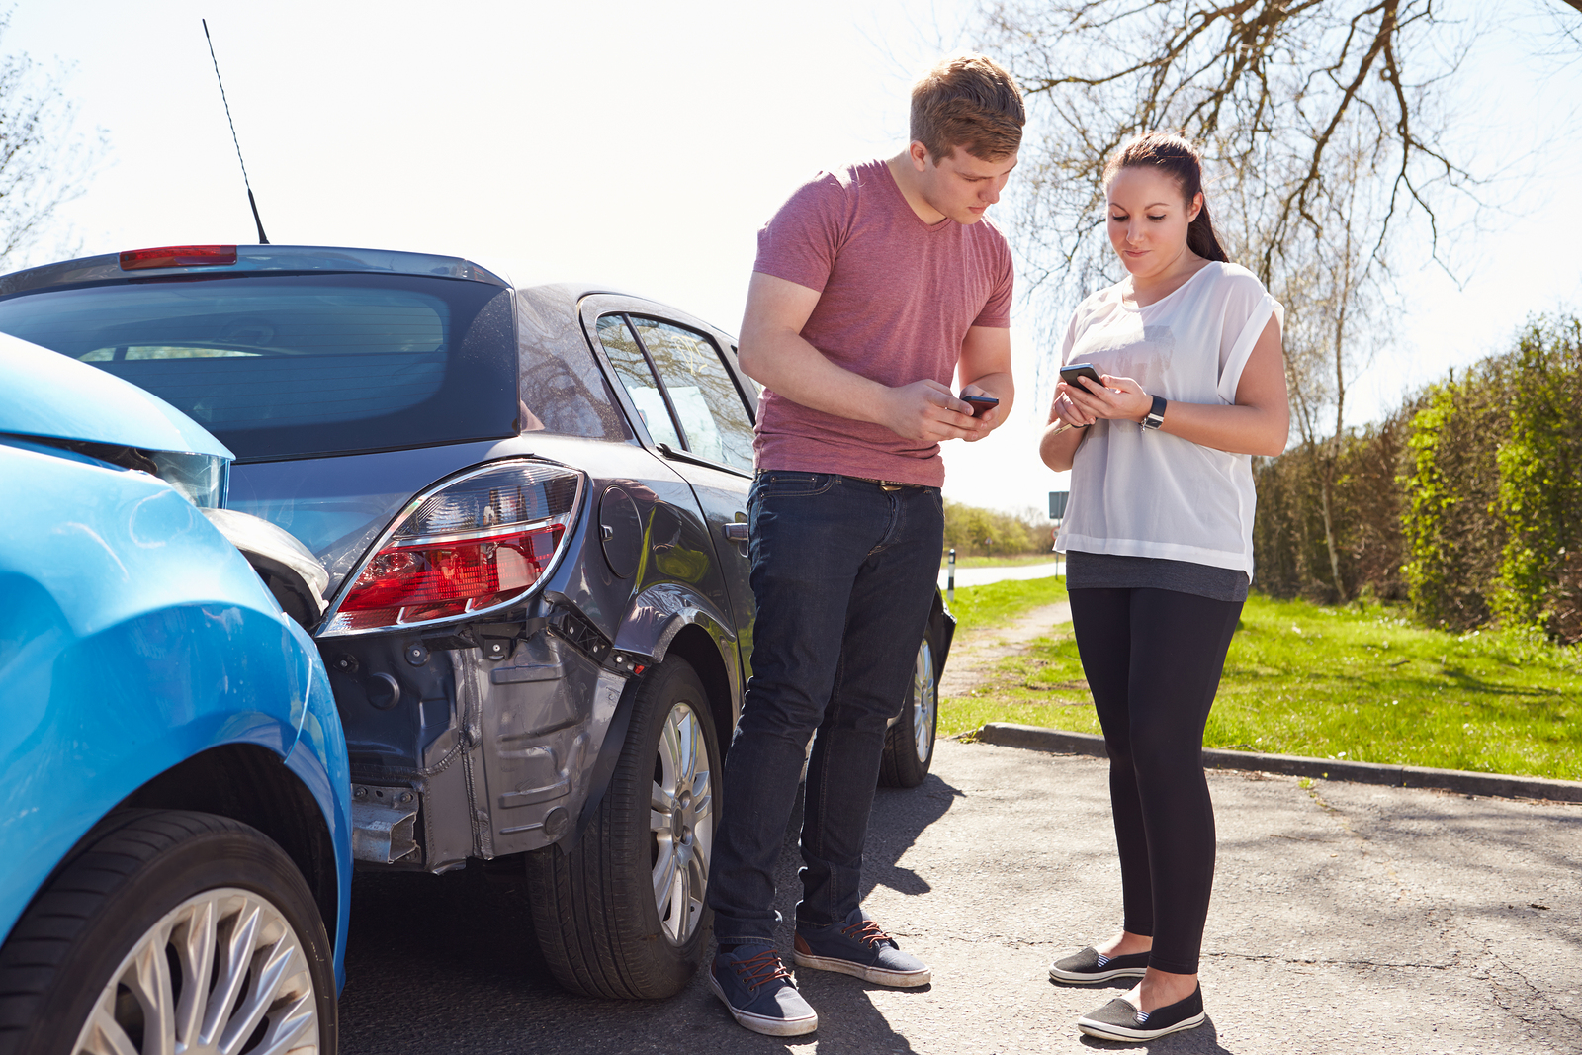
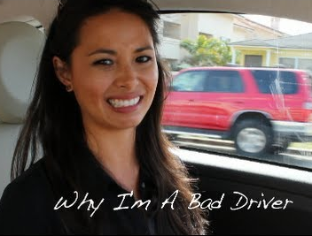
5. Psychosocial Abilities
Role
Performance
Social Conduct
Interpersonal
Skills
Self
Concept
Notes:
Communication and social skills are used as individuals exchange information, relate, and physically communicate to move through a community in which other individuals are also mobile. (AOTA, 2008)
Can the teen interact with a police officer if he/she is pulled over or another driver if they are in an accident? Will the situation overwhelm them?

Slide 26
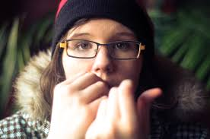
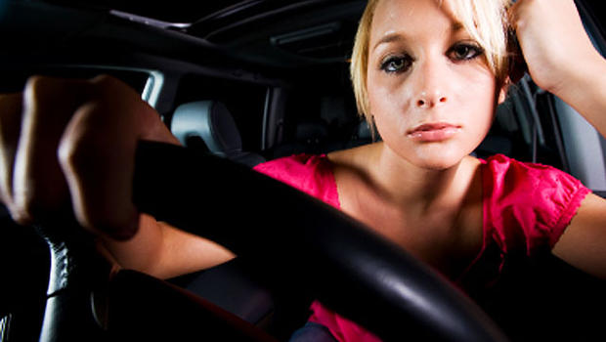
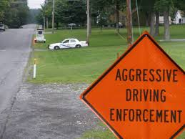
6. Psychological Profile
Stress Management/
Coping Skills
Organization/
Time Management
Self-Awareness,
Control
Notes:
Emotional regulation is used while engaging in driving and community mobility to perform appropriately on shared roadways and pathways with other users. (AOTA, 2008)
Is the teen capable of creating important coping strategies for possible problems that may occur when driving?
ex: traffic, detours, wrecks

Slide 27
Pre-Driving “Readiness” Assessment Tools
ADL/IADLs: *Obs/Report, Custom vs. Standardized
PEDI, AMPS, FIM, Klein-Bell Scale, SOTOF
Sensory: Sensory Profile, SPM, Clinical *Obs, Visual Perceptual
Neuromusculoskeletal: ROM, MMT, Reflex Testing
Motor/Visual: BOT-2, GOAL, “Beery VMI”, Ocular Motility
Cognitive Integration: Piaget’s Inventory/PIE, *Obs/Teacher Report, SNAP-IV/NICHQ Vanderbilt Assessment Scale, Educational Diagnostician
Psychosocial: *Obs/Speech Therapy or Recreation Therapist Findings
Psychological: *Obs/Parent Report, Counselor/Neuropsych Findings
Notes:
These are assessment tools that are relatively common in the pediatric therapy field or which can be done after a little bit of extra training. While these are not driving rehab
assessments, it’s important to understand that driving rehab assessments are not necessary or really all that appropriate when determining driving readiness. Furthermore, from an ethics point of view we must all only provide what we have the skills training and competences to do so with. AOTA has a really great ethics course on driving that I’d recommend you consider taking if interested in this field of practice.

Slide 28
Treatment & Home Program Options
Therapeutic Exercises/Activities
Strength, Coordination, Processing/Multitasking & Functional Vision Activities
Ready Bodies Learning Minds® or other reflex integration & ROM activities
Superflex®, Zones of Regulation®, & other Social Thinking®/Sensory programs
Extracurricular Activities
Sports, Band, Art/Theatre, Clubs, Organizations, Gaming
Cutting-edge technologies
Drive Focus®, Brain HQ, Interactive Metronome®, iLs®, Gaming/Apps
These modalities help build skills of noticing, prioritizing, and reacting to information both quickly and over time.
Notes:
Driving program previously known as Drive Fit is now called Drive Focus
Brain HQ has In Gear program with AAA
IM works on timing, iLs works on sensory motor functions

Slide 29
Driving Readiness for Teens (DRT) Therapy & (DRH) Helper Program ©
Notes:
Refer to us! We also have a DRH which you can purchase from us.
Who we see verses who St. David’s sees & our credentials
If you are looking for driving aides and modifications:
Consider “Advanced Mobility Systems of Texas” (Dallas/Fort Worth, Austin) http://www.advancedmobility.net/

